Slide 1
Generating training set of online signatures
Khazar Mammadli , W4fWIU
Supervisor: Mohammad Saleem
Department of automation and applied informatics

Slide 2
Description of the Task
Implement a C# code that generates an artificial signature from a real signature to use it for online signature verification. We have some signature databases with online signatures represented in X, Y coordinates and other features. Using these points, the student must implement a code to generate similar signatures for the same signer.

Slide 3
Detailed description of the task
I have been given a dataset of signatures from Signature Verification Competition 2004. This dataset contains 40 different signatures from 40 different people and each signature varies from the previous one made by the same person. Each signature contains the following data which is given in a text file which is named according to a preset template name(U_S_):
X-coordinate - scaled cursor position along the x-axis (0th column) Y-coordinate - scaled cursor position along the y-axis (1st column) Time stamp - system time at which the event was posted (2nd column) Button status - current button status (0 for pen-up and 1 for pen-down) (3rd column) Azimuth - clockwise rotation of cursor about the z-axis (4th column) Altitude - angle upward toward the positive z-axis (5th column) Pressure - adjusted state of the normal pressure (6th column)

Slide 4
Visualization of signatures
The next two slides shows us a visualization of the signatures. To visualize the signatures only the X and Y coordinates of the points given in the signature’s text file have been used (as the other details are not applicable to visualization). The first one shows the signature in a pure form without giving too much details such as locations of the points and a grid that eases the visibility and altercation of the signature

Slide 5
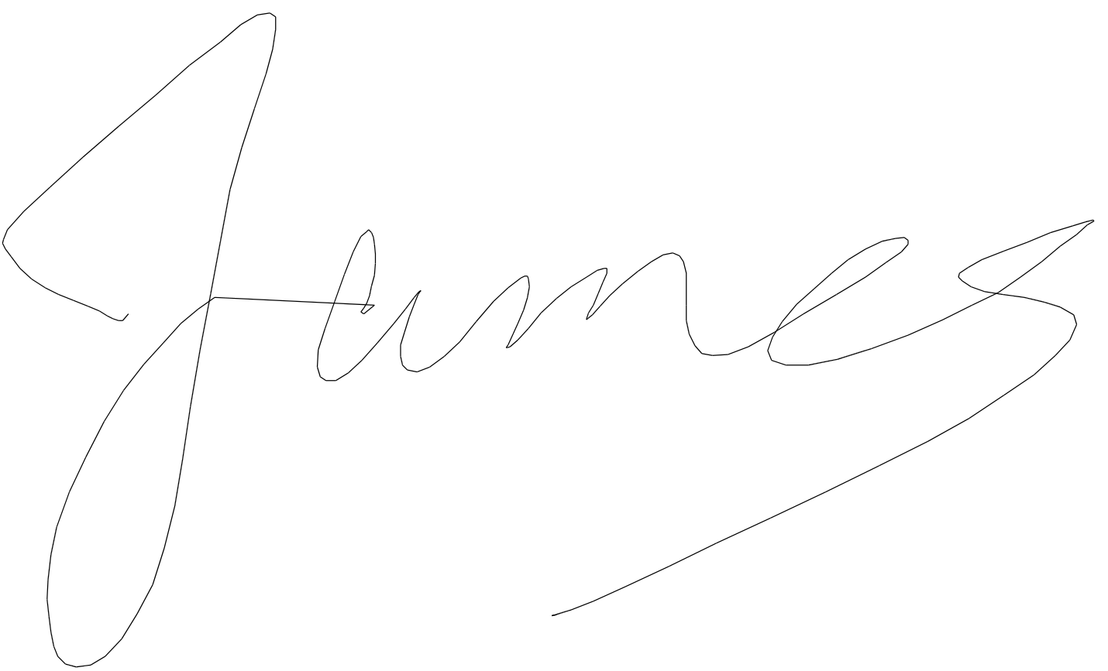

Slide 6
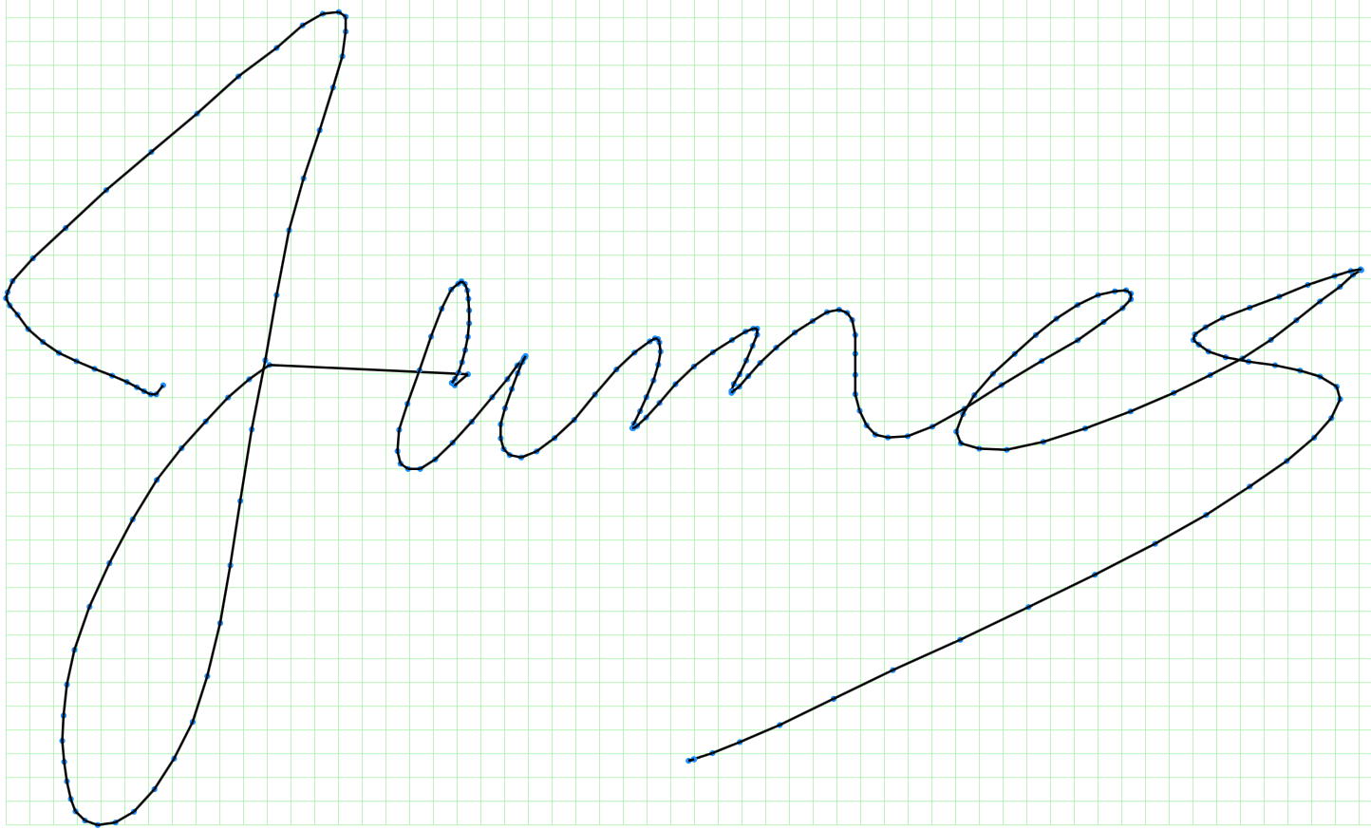

Slide 7
Explanation of approach
Human signature is presented as an array of points. The goal is to change points locations so that the resulting “distorted” signature could still be recognized as one produced by the same person’s handwriting.
The ultimate solution would be to ask the person to produce as many copies of the signature manually and then train a neural network of some kind to produce similar variations.
Here we are making an attempt to apply a specific algorithm to the original array of points in the hope that even though the signature variations are going to be somewhat predetermined they would still resemble the ones that normally occur when an actual person tries to repeat his/her own handwriting.

Slide 8
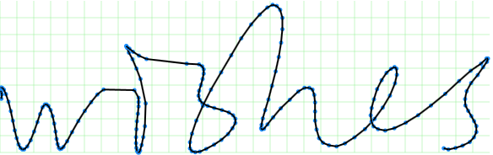
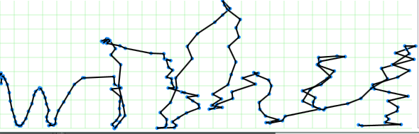
First method: Randomization of coordinates
Random values are added to both X and Y (within about 10% of the original value). It expectedly causes the “shaken hand” effect:

Slide 9
Explanation of approach
This presents a challenge. In real life signature variations are indeed random but not as random as in the previous slide. The different parts of signature may slightly change their shape or size or be shifted towards or from each other but there is a certain amount of dependency between the points. If Nth point moves 1 cm to the left there is a great chance that (N-1)th and (N+1)th points will also move roughly to the same direction but maybe not exactly the same distance. So I have come up with the second method which is:

Slide 10
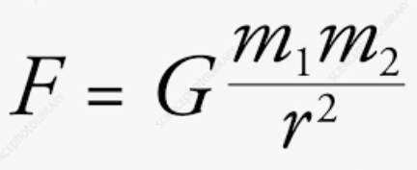
Second method: Gravity distortion
In order to meet the challenge we need to find a principle that would affect different points of the signature array in different ways while still preserving the basic humanly-recognizable shape of the curve.
One physical principle that satisfies this requirement is gravity. A center of gravity (e.g. Sun) attracts different masses (e.g. planets) to itself with different forces depending on how far they are from the center:

Slide 11
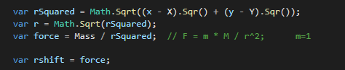
Second method: Gravity distortion
So, we introduce a gravity center into our “signature space”. It will draw signature points to itself. The more a point is attracted the more it shifts towards the center. Since all signature points have the same mass the attraction force (and the shift distance) will depend only on center’s mass and it’s distance to a given point:

Slide 12
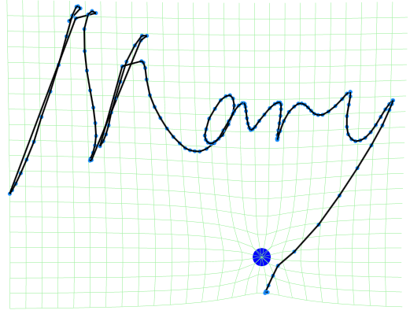
Second method: Gravity distortion
Another way to look at this is to imagine that the surface on which signatures are drawn is made of rubber. Putting a metal ball on the surface will cause it to stretch in a similar way. (Search “rubber sheet gravity” if anyone is interested)
The result is much more “natural” than method 1:

Slide 13
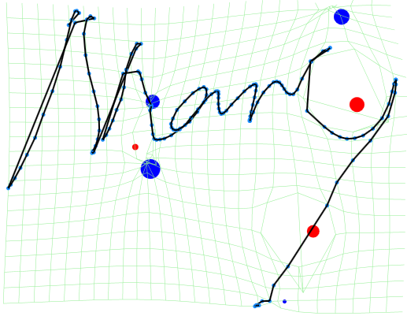
Second method: Gravity distortion
To make it even more realistic we introduce multiple gravity centers and compute the resulting shift as vector sum of individual shifts caused by each center.
We also allow both positive (attracting) masses and negative (repelling).
Masses are random, their number is random and controlled by DefaultMassdensity param, they are placed randomly.
A typical result:

Slide 14
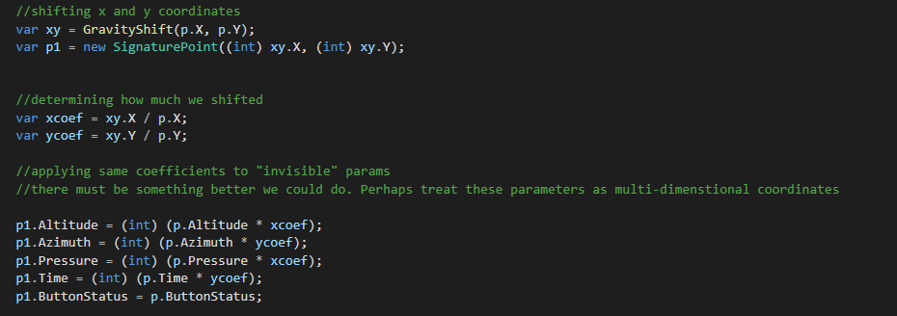
Second method: Gravity distortion
Having completed the task of changing points locations we still have the “invisible” parameters left to modify (pressure, azimuth etc).
There is likely a connection between the coordinates and “invisible” parameters: If a certain loop on a signature is larger than usual than it was probably drawn by applying more (or less) pressure to the pen. Without knowing the nature of this connection the least we can do is apply the same law to invisible parameters as we did to coordinates:

Slide 15
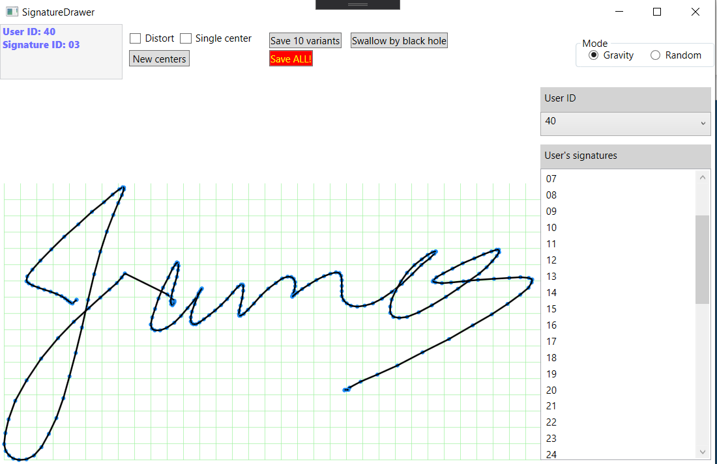
Further technical details and demonstration
The UI is really simplistic with descriptive buttons
User ID combobox is used to select the user and User’s signature listbox allows you to select the available signatures()
There is mode selector to switch between Random and Gravity methods
New centers button adds new random gravity points to the signature and Distort checkbox that initiates the gravity.
Single checkbox limits the number of gravity points to only one (everytime the New centers is pressed)
Save 10 variants will do 10 distortions and save the generated signature files according to the template name and will store them in the Resources/Task2 folder(Current destination for the all signature files). The created files will have their name according to the predifined template (U_S_8000_/U_S_9000_ First blank being the user, second the signature that has been distorted, 8000/9000 according to the method used and last being the incremental number )
Save ALL function will create 10 distorted signatures for every signature in the working directory. This is not really recommended as the program might not be able to load all the signatures that we’re loaded on restart.
You have to restart the program when saving the new distortions for them to appear in the signature listbox.
And lastly Swallow by black hole: Use it if you really dislike someones signature and would like to see it be gone before your eyes

Slide 16
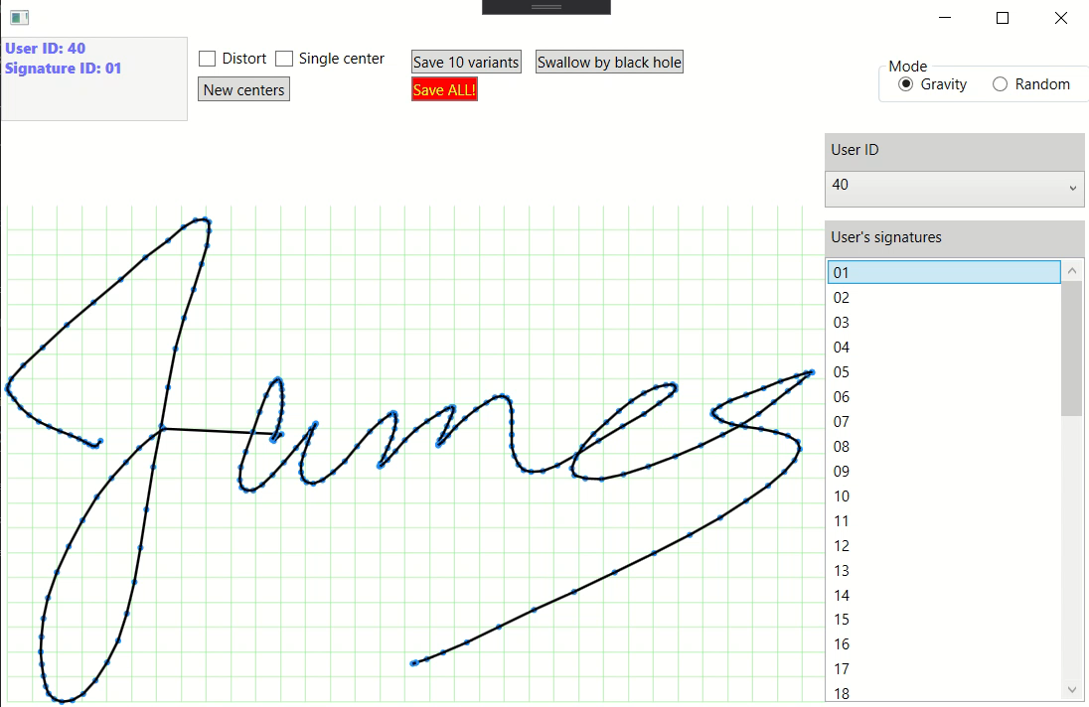
Further technical details and demonstration

Slide 17
Questions?

